Slide 1
Sales Performance Project
Improve sales performance

Slide 2
Business Request
Steven – Sales Manager:
Hi Donia!
I hope you are doing well. We need to improve our internet sales reports and want to move from static reports to visual dashboards.
Essentially, we want to focus it on how much we have sold of what products, to which clients and how it has been over time.
Seeing as each sales person works on different products and customers it would be beneficial to be able to filter them also.
We measure our numbers against budget so I added that in a spreadsheet so we can compare our values against performance.
The budget is for 2021 and we usually look 2 years back in time when we do analysis of sales.
Let me know if you need anything else!
//Steven

Slide 3
NO # | AS a (Role) | I want (Request\Demand) | So that I (User Value) | Acceptance Criteria
­1 | Sales Manager | To get a dashboard overview of internet sales. | Can follow better which customers and products sells the best. | A power Bi dashboard which updates data once a day
2 | Sales Representative | A detailed overview of Internet Sales per Customers | Can follow up my Customers that buys the most and who we can sell are to | A power BI dashboard which allows me to filter data for each customer
3 | Sales Representative | A detailed overview of Internet Sales per Products | Can follow up my Products that sells the most | A power BI dashboard which allows me to filter data for each product
4 | Sales Manager | A dashboard overview of internet sales | Follow Sales over time against budget | A power Bi dashboard with graphs and KPIs comparing against budget

Slide 4
Dashboard Design Process Sales Overview
This report provides a comprehensive view of sales visually through a set of indicators and charts.
and This report allows users to quickly and effectively monitor and analyze sales performance, helping to make informed decisions.

Slide 5
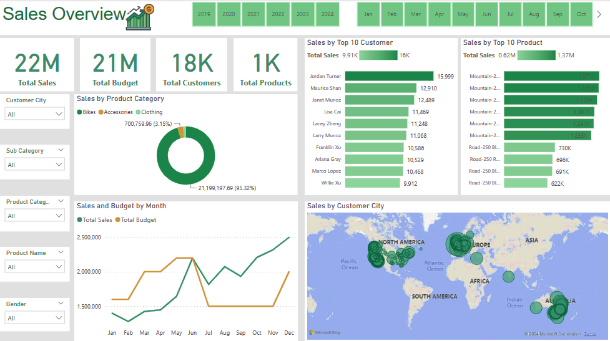

Slide 6
Customer Details
This report is called Customer Details, and it focuses on customer details
and the sales associated with them.
Provides detailed insight into customer Performance and
monthly sales, helping to analyze trends and make data-driven decisions.

Slide 7
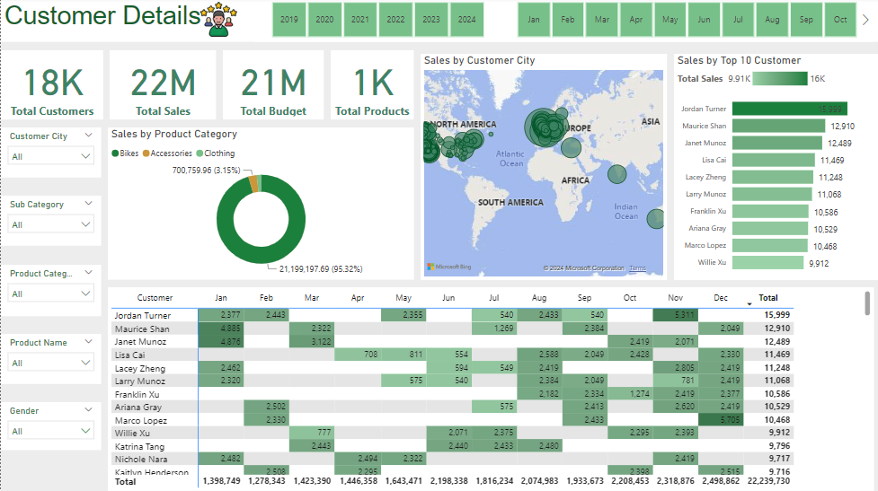

Slide 8
Product Details
This report displays sales details for products in general and in detail by different categories, using an interactive dashboard.
The report shows strong performance in the second half of the year,
specifically between October and December, which could indicate a high selling season.

Slide 9
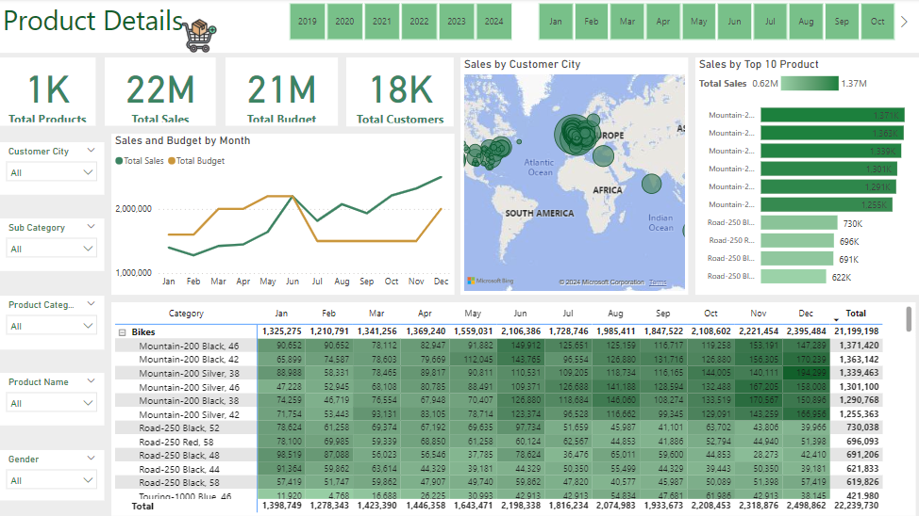

Slide 10
Thank You
Donia Al-Badawi

